Slide 1
CHAPTER 3
Oracle9i:
An Overview

Slide 2
IN THIS CHAPTER . . .
You will learn the differences between a client/server database, such as Oracle, and
PC - based database software.
The Oracle client/server Database Management System (DBMS) and its utilities.
The Oracle development environment SQL*Plus and its various types of commands.
Overview of primary language SQL (Structured Query Language) to communicate with the Oracle Server.
SQL*Plus Worksheet and iSQL*Plus environments.
Designs of two case study databases, a college’s student registration database system and a company’s employee database system.

Slide 3
PERSONAL DATABASES
Personal database management systems, such as Microsoft Access and Visual Fox Pro, are usually stored on a user’s desktop computer system or a client computer. These database packages are developed primarily for single-user applications. When such a package is used for a multiuser or a shared access environment, the database applications and the data are stored on a file server, or a server, and data are transmitted to the client computers over the network (see Figure in the next slide)
A server is a computer that accepts and services requests from other computers, such as client computers. A server also enables other computers to share resources. A server’s resources could include the server’s hard-disk drive space, application programs on a server’s hard drive, data stored on the server’s drive, or printers.
A network is an infrastructure of hardware and software that enables computers to communicate with each other.

Slide 4
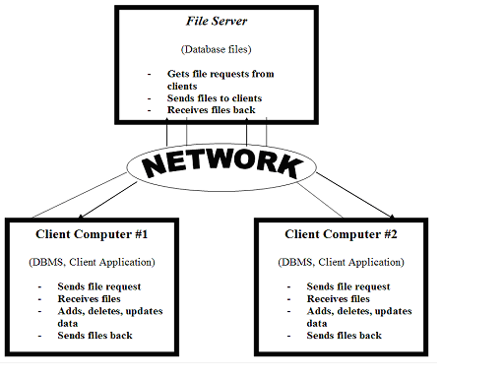
PERSONAL DATABASES

Slide 5
PERSONAL DATABASES
Demand on Client and Network
In a network environment with a personal DBMS, the client computer must load the entire database application along with the client database application in its memory. If the client requires a small piece of data from the server’s large database, the server has to transmit the entire database to the client over the network. In some database packages, only part of the database is transmitted. In any case, the client computer hardware must handle heavy demand, and the network must sustain heavy traffic in both directions. In the network environment, the system response to various client requests depends on the speed of the network and the amount of traffic over it.
Table Locking
The personal database system assumes that no two transactions will happen at the same time on one table, which is known as optimistic locking. In optimistic locking, the tables are not locked by the database system. If one agent sells a seat for a basketball game and another agent tries to sell the same seat at the same time, the database system will notify the second agent about the update on the table after his or her read - but it will go ahead and let the second agent sell the seat anyway. Application programmers can write code to avoid such a situation, but that requires added effort on programmer’s part. Personal database software does not lock tables automatically.

Slide 6
PERSONAL DATABASES
Client Failure
When a client is performing record insertions, deletions, or updates, those records are locked by that client and are not available to the other clients. Now, if the client with all the record locks fails because of software or hardware malfunction or a power outage, the locked records stay locked. The transactions in progress at the time of failure are lost. The database can get corrupted and needs to be repaired. To repair the database, all users have to log off during the repair, which can take anywhere from a few minutes to a few hours! If the database is not repairable, data can be restored from the last backup, but the transactions since the last backup are lost and have to be reentered.
Transaction Processing
Personal databases, such as Microsoft Access, do not have file-based transaction logging. Instead, transactions are logged in the client’s memory. If the client fails in the middle of a batch of transactions, some transactions are written to the database and some are not. The transaction log is lost, because it is not stored in a file. If a client writes a check to transfer money from a savings account to a checking account, the first transaction debits money from the savings account. Now, suppose the client fails right after that. The checking account never gets credited with the amount, because the second transaction is lost!

Slide 7
CLIENT/SERVER DATABASES
Client/server databases, such as Oracle, run the DBMS as a process on the server and run a client database application on each client. The client application sends a request for data over the network to the server. When the server receives the client request, the DBMS retrieves data from the database, performs the required processing on the data, and sends only the requested data (or query result) back to the client over the network (see Figure in the next slide).

Slide 8
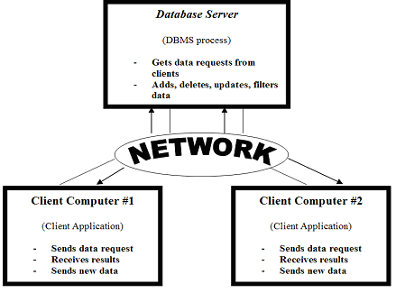
CLIENT/SERVER DATABASES

Slide 9
CLIENT/SERVER DATABASES
Demand on Client and Network
The client computer does not run the entire DBMS, only the client application that requests data from the server. The client does not store any database on its local drive, it receives only the requested data from the server. Data processing is performed on the server’s side. The demand at the client’s end is minimal. The clients request data from the server, and only the requested data are sent back via the network, which results in less network traffic.
Table Locking
In a client/server system, such as Oracle, when an agent reads a table to sell a seat for a basketball game, for example, it is locked totally or partly by the DBMS. The second agent cannot read the part of the table with available seats. Once the first agent sells the seat and it is marked as sold, the lock is released for the next agent. The DBMS takes care of the locking automatically, and it involves no extra effort on an application programmer’s part.

Slide 10
CLIENT/SERVER DATABASES
Client Failure
In case of a client failure, the client/server database is not affected. The other clients are not affected either. Only the failed client’s transactions in progress are lost. If the server fails, a central transaction log, which keeps a log of all current database changes, allows the Database Administrator (DBA) or DBMS to complete or roll back unfinished transactions. The rolled-back transactions are not implemented in the database. The DBA (or DBMS) can notify clients to resubmit rolled-back transactions. Most client/server database packages have fast and powerful recovery utilities.
Transaction Processing
If a grouped transaction or batch transaction fails in the middle, all transactions are rolled back. The DBMS will enable the bank, for example, to make sure that both accounts’ balances are changed if the batch transaction goes through. If the batch transaction fails, the balance in none of the accounts is changed.

Slide 11
ORACLE9i: AN INTRODUCTION
Oracle9i is one of the most popular database-management software packages available today. Oracle9i database is capable of supporting over 10,000 simultaneous users and a database size of up to 100 terabytes. It is preferred to the other PC-based RDBMS packages because its client/server database qualities, failure handling, recovery management, administrative tools to manage users and the database, object-oriented capabilities, graphical user interface (GUI) tools, and Web interface capabilities. It is widely used by corporations of all sizes to develop mission-critical applications. It is also used as a teaching tool by educational institutions to teach object-relational database technology, Structured Query Language (SQL), PL/SQL (Oracle’s procedural language extension to SQL), and interfacing Web and Oracle databases. Oracle has an educational initiative program to form partnerships with educational institutions that enables institutions to receive software at a nominal fee.

Slide 12
ORACLE9i: AN INTRODUCTION
Some of the Oracle9i tools include:
SQL*Plus - The SQL*Plus environment is for writing command-line SQL queries to work with database objects such as tables, views, synonyms, and sequences.
PL/SQL - PL/SQL is Oracle’s extension to SQL for creating procedural code to manipulate data.
Developer Suit - This tool is used for developing database applications and includes:
· JDeveloper—a Java development tool.
· Designer—to model business processes and generate Enterprise applications.
· Forms Developer—a developement tool for Internet and client/server–based environment.
· Oracle Reports—a report generation tool.
Enterprise Manager - A tool for managing users and databases. Enterprise Manager uses the following tools:
· Storage Manager—to create and manage “tablespaces”.
· Instance Manager—to start, stop, or tune databases.
· Security Manager—to create and manage users, profiles, and roles.
· Warehouse Manager—to manage data warehousing applications.
· XML Database Manager – to render traditional database data as XML for e-business support.
· SQL Worksheet—to enter, edit, and execute SQL*Plus code or to run client-side scripts.
· iSQL*Plus—a Web-based environment to execute SQL*Plus code.
Oracle Application Server (Oracle9iAS) - A tool for creating a web site that allows users to access Oracle databases through web pages. It includes:
· Web Server.

Slide 13
ORACLE9i: THE SQL*PLUS ENVIRONMENT
When a user logs in to connect to the Oracle server, SQL*Plus provides the user with the SQL> prompt, where the user writes queries or commands. Features of SQL*Plus include:
· Accepts ad hoc entry of statements at the command line prompt (i.e.,SQL>).
· Accepts SQL statements from files.
· Provides a line editor for modifying SQL queries.
· Provides environment, editor, format, execution, interaction, and file commands.
· Formats query results, and displays reports on the screen.
· Controls environmental settings.
· Accesses local and remote databases.

Slide 14
ORACLE9i: STRUCTURED QUERY LANGUAGE (SQL)
The standard query language for relational databases is SQL (Structured Query Language). It is standardized and accepted by ANSI (American National Standards Institute) and the ISO (International Organization for Standardization).
Structured Query Language is a fourth-generation, high-level, nonprocedural language, unlike third-generation compiler languages such as C, COBOL, or Visual Basic, which are procedural. Using a nonprocedural language query, a user requests data from the RDBMS.
The SQL language uses English-like commands such as CREATE, INSERT, DELETE, UPDATE, and DROP. The SQL language is standardized, and its syntax is the same across most RDBMS packages. The different packages have minor variations, however, they do support some additional commands. Oracle’s SQL is different from the ANSI SQL. Oracle’s SQL is referred to as SQL*, but we will simply call it SQL throughout this text. Oracle9i also supports ANSI syntax for joining tables.

Slide 15
ORACLE9i: STRUCTURED QUERY LANGUAGE (SQL)
Oracle9i uses the following types of SQL statements for
command-line queries to communicate with the Oracle server
from any tool or application:
Data retrieval - retrieves data from the database (e.g., SELECT).
Data Manipulation Language (DML) - inserts new rows, changes existing rows, and removes unwanted rows, (e.g., INSERT, UPDATE, and DELETE).
Data Definition Language (DDL) - creates, changes, and removes a table’s structure (e.g., CREATE, ALTER, DROP, RENAME, and TRUNCATE).
Transaction control - manages and changes logical transactions. Transactions are changes made to the data by DML statements that are grouped together (e.g., COMMIT, SAVEPOINT, and ROLLBACK).
Data Control Language (DCL) - gives and removes rights to Oracle objects (e.g., GRANT and REVOKE).

Slide 16
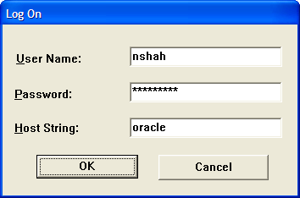
SQL - LOGGING IN TO SQL*PLUS
In the Windows environment, click Start | Programs | Oracle – Orahome92 | Application Development | SQL Plus. A Logon window will pop up. Enter your Username, Password, and Host String as provided by your Database Administrator.

Slide 17
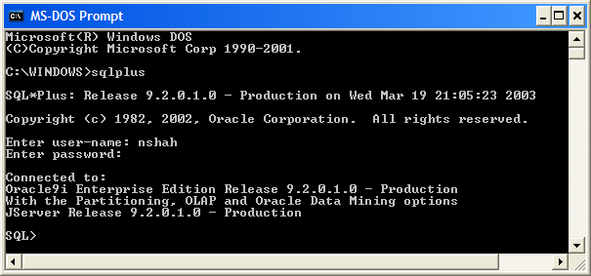
SQL - LOGGING IN TO SQL*PLUS
In a command-line environment such as DOS, type sqlplus [username [/password [@host/database]]] to log in. If the entire command is typed, the password will be visible on the screen. If you enter your username only, a prompt will be displayed for your password. The password typed at this prompt will be masked to maintain its integrity.

Slide 18
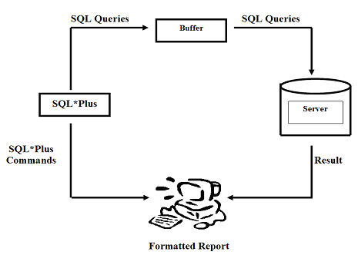
Interaction between SQL*Plus and SQL
A query typed at the prompt is loaded in to the SQL*Plus buffer. When the query is sent to the server, the server processes data and sends back the result to the client computer, which can be formatted using SQL*Plus formatting commands.

Slide 19
SQL*Plus Help
SQL*Plus also provides the user with HELP on its various commands and SQL language. You may use the HELP INDEX command at the SQL> prompt to list the SQL*Plus commands. To obtain help on one of the topics listed in the help index, type INDEX [TOPIC]. For example, type HELP DESCRIBE as shown in Figure 3-13, and SQL*Plus returns a brief description and syntax on the topic.
SQL> HELP INDEX Enter Help [topic] for help. @ COPY PAUSE SHUTDOWN @@ DEFINE PRINT SPOOL / DEL PROMPT SQLPLUS ACCEPT DESCRIBE QUIT START APPEND DISCONNECT RECOVER STARTUP ARCHIVE LOG EDIT REMARK STORE ATTRIBUTE EXECUTE REPFOOTER TIMING BREAK EXIT REPHEADER TTITLE BTITLE GET RESERVED WORDS (SQL) UNDEFINE CHANGE HELP RESERVED WORDS (PL/SQL) VARIABLE CLEAR HOST RUN WHENEVER OSERROR COLUMN INPUT SAVE WHENEVER SQLERROR COMPUTE LIST SET CONNECT PASSWORD SHOW SQL> HELP DESCRIBE DESCRIBE -------- Lists the column definitions for a table, view, or synonym, or the specifications for a function or procedure. DESC[RIBE] {[schema.]object[@connect_identifier]} SQL>

Slide 20
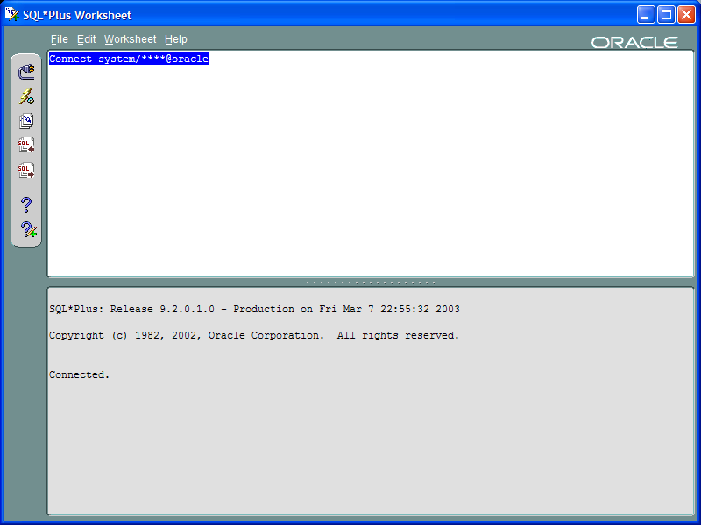
SQL*PLUS WORKSHEET
The SQL*Plus Worksheet is another environment available with Oracle’s Enterprise Manager. The SQL*Plus Worksheet enables you to enter, edit, and execute SQL*Plus code. You can also run client-side scripts. The SQL*Plus Worksheet maintains a history of the commands you have issued, so you can easily retrieve and re-execute previous commands. You can execute SQL*Plus Worksheet by double-clicking on the SQL*Plus Worksheet icon in the Windows’ desktop or by selecting the following from the Windows’ START button:
START | [All] Programs | Oracle – OraHome92 |
Application Development | SQLPlus Worksheet

Slide 21
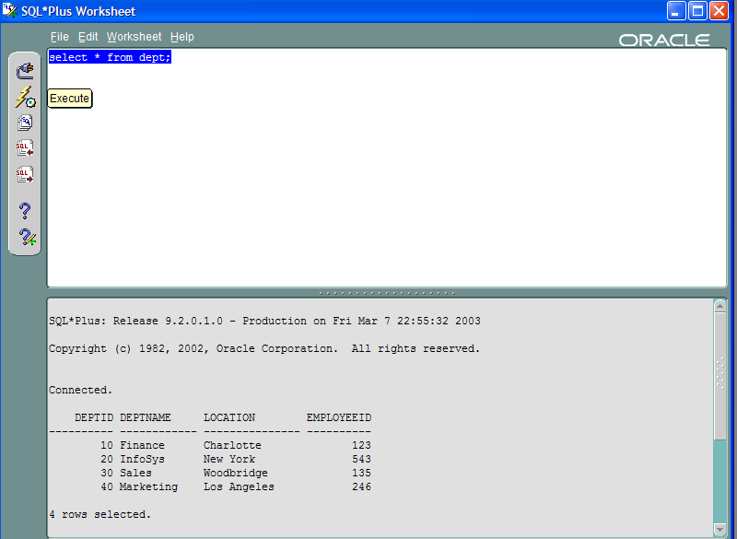
SQL*PLUS WORKSHEET
The SQL*Plus Worksheet screen has two horizontal halves. User issues SQL query or SQL*Plus command in the upper half, and then clicks on the lightening bolt icon to execute. During a session, user issues many commands and statements. Unlike SQL*Plus, SQL*Plus Worksheet keeps all commands and statements in history. User can click on Command History icon to view them in reverse order with the most recent command at the top. User can select a command/statement and click on GET button to load it again, and execute it.
User may save input and output in separate files with the FILE menu and its options Save Input As… and Save Output As… respectively. The input is stored in file with default extension sql, and output is stored with default extension txt.

Slide 22
Differences between SQL*Plus and SQL*Plus Worksheet
The following settings have been set up by Oracle Enterprise
Manager SQL*Plus Worksheet. It is recommended that users do
not change them.
The sqlplus system variable SQLPROMPT is disabled by default.
The sqlplus system variable SQLNUMBER is set to OFF by default.
The sqlplus system variable PAGESIZE is set to its maximum by default.
The sqlplus system variable TAB is set to OFF by default.
If there are any prompt characters "&" in a script, SQL*Plus treats it as a "define" prompt. (You will see more on DEFINE later)
The HOST command is not supported in SQL*Plus Worksheet.
The SQL*Plus user variable _EDITOR is disabled by default. If you enable it by using "DEFINE _EDITOR = 'editorname'", the specified editor launches on the server when you type the "EDIT" command. As a result, you are unable to access normal SQL*Plus Worksheet functionalities.
Remote execution is not supported.
Remote load and save of script files is not supported.

Slide 23
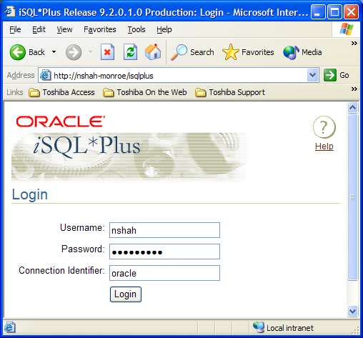
iSQL*PLUS
The third environment is web-based, and is called iSQL*Plus. To access it through a web browser, enter a URL as follows:
http://machinename.domainname:port/isqlplus
Where machine name is your machine, and port number is not required in all versions.
Where nshah-monroe is the machine name. The domain name is not used because iSQL*Plus is located in the local machine. In the login dialog, connection identifier (or host string) is optional, if the URL points to the correct database instance. Consult your IT or lab personnel for information on server name, domain name, default port and database name at your installation or college.
Another URLs http://localhost:port/isqlplus or https://localhost:port/isqlplus can be used, if URL with computer name does not work. During installation of Oracle9i, Oracle installer provides the port number to access HTTP (Apache) server.

Slide 24
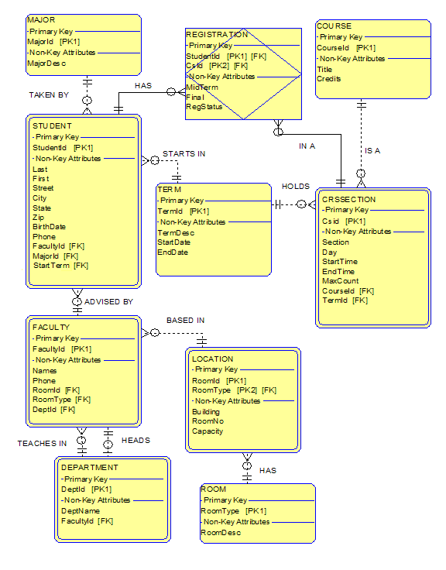
Indo-US (IU) College Database E-R Diagram

Slide 25
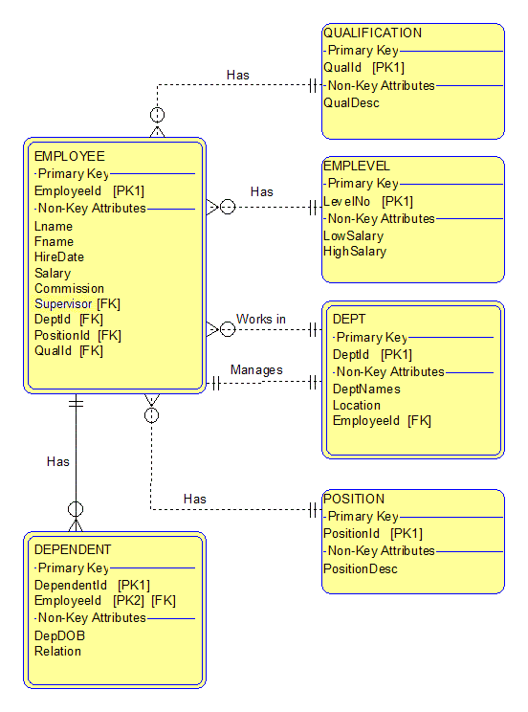
N2 Corporation Database E-R Diagram

